Slide 1
OOP project
Case Number Converter
Group members:
Darren Ivano 2602079590
Richard Limec 2602074116

Slide 2
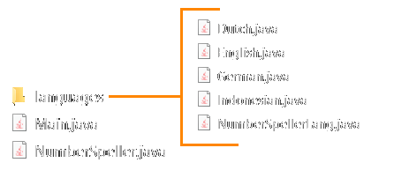
Basics
Main handles user input & printing to all languages
Languages are objects that implements from NumberSpellerLang
NumberSpeller handles the conversion to the spelling

Slide 3

Converter basics
Inputs are handled as strings
Numbers are separated into segment of threes (apart from any
Result is saved into a string builder called result
Each three-letter segment is processed individually on a loop by printRes, extra information like placement is included (to determine the scale and some other stuff)
Before the result of each segment is appended to the final output, specific rules are checked to change specific wording (if there are any), e.g: “satu juta” replaced with “sejuta”. This rule can be set to be exact (to prevent 61000 from being “enam sejuta” instead of enam ribu juta”) / replace any occurrence of the keywords.

Slide 4
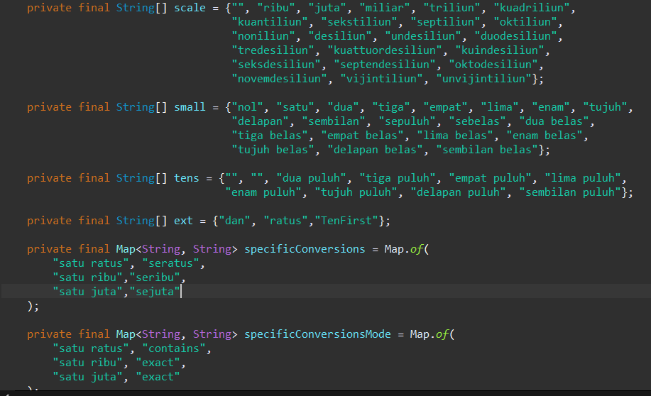
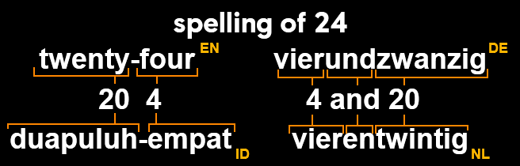
Language basics
Languages consists of:
A list of large scale for anything over 1o²
A lost for small numbers ranging from 1-20 (as most languages have specific wording for them), as well as the tens
Extra language specific configurations
A Customizable list for extra specific word conversion rules stored in a map
TenFirst / TenAfter is used to differentiate between languages where ones go before tens or the other way around

Slide 5
Basic steps to add a new language in this system
Create a new java obj for the language, with the translated terms
Import it to main
Add the new language to the converter
Done

Slide 6
Additional notes
Long scale terms the german and dutch version were translated using google translate and checked w/ ChatGPT. Errors may be present
Removing the use of “and” can be done by removing these lines from NumberSpeller:
if (num % 100 != 0) {
result.append(" ").append(lang.getExt()[0]).append(" ");
}
moreFlag = true;

